Slide 1

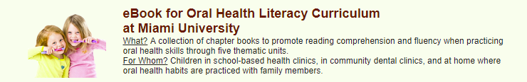
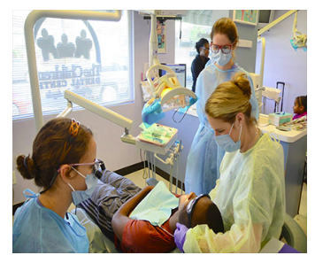
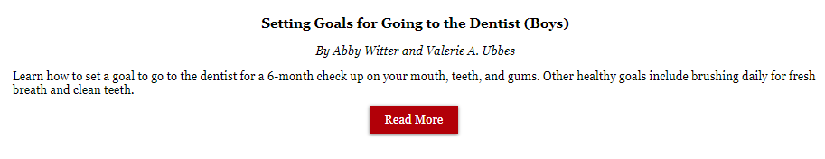
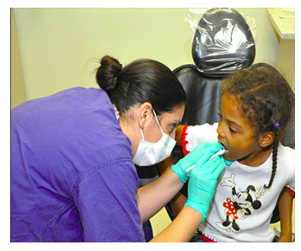
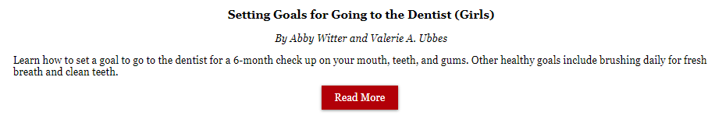
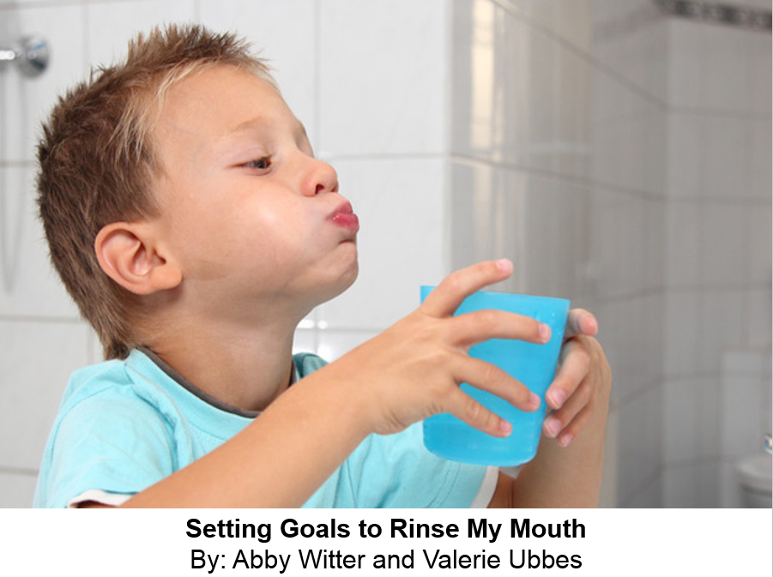
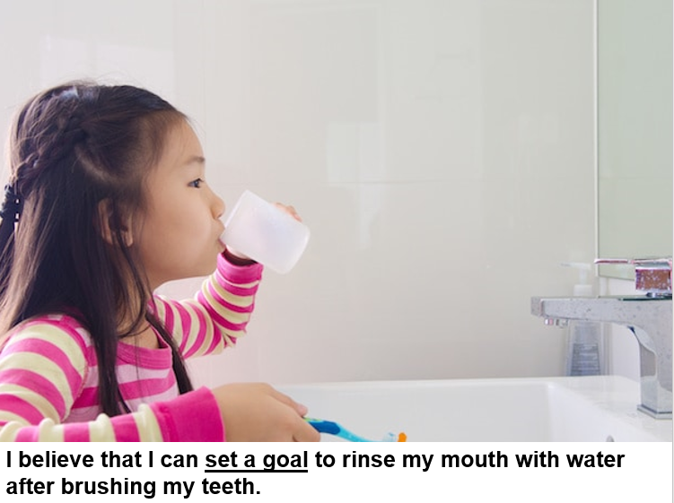
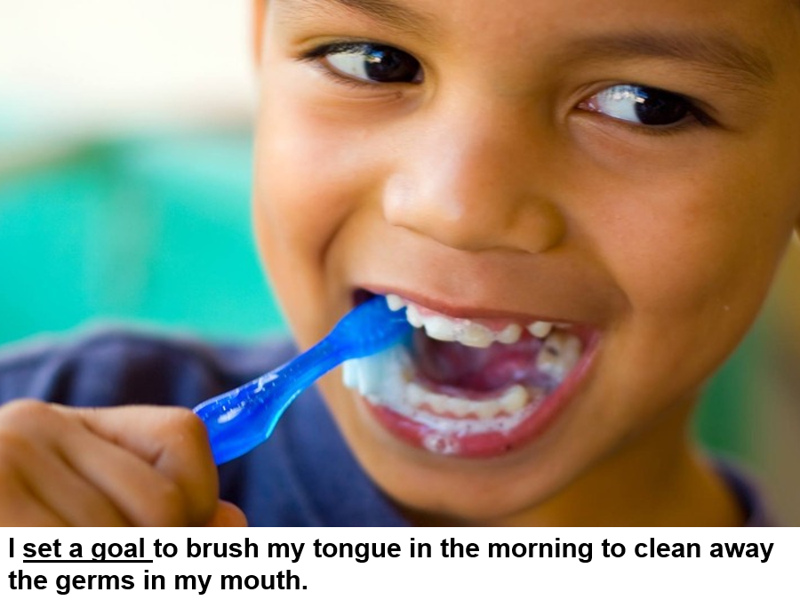
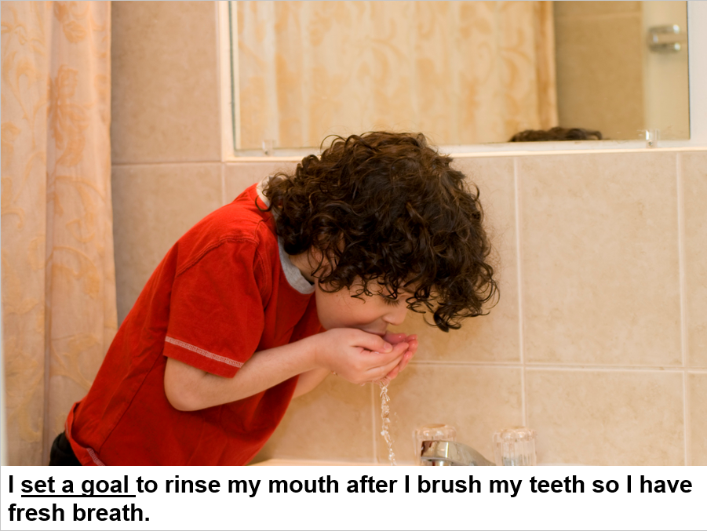
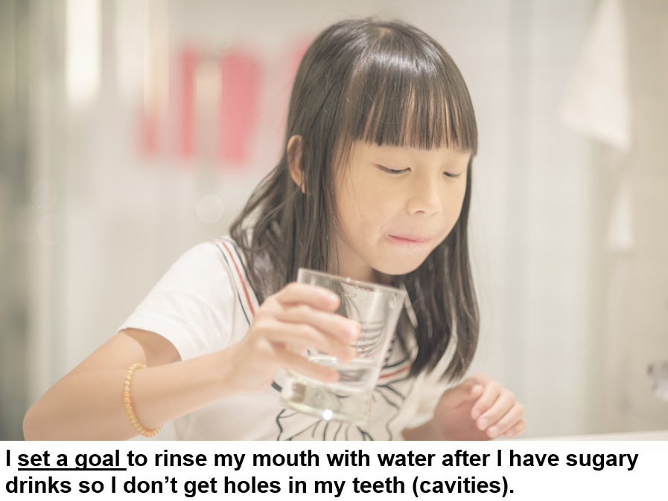
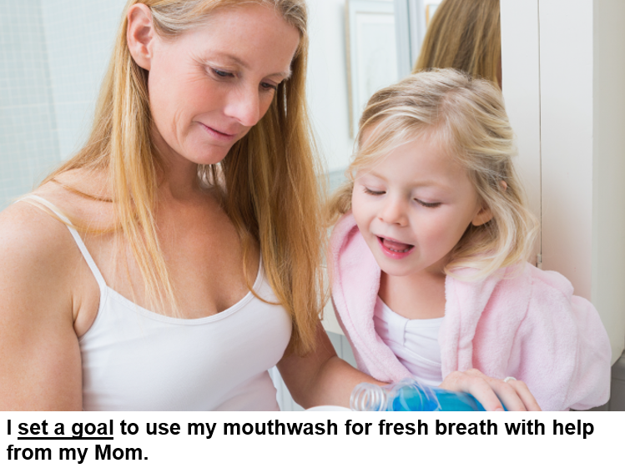
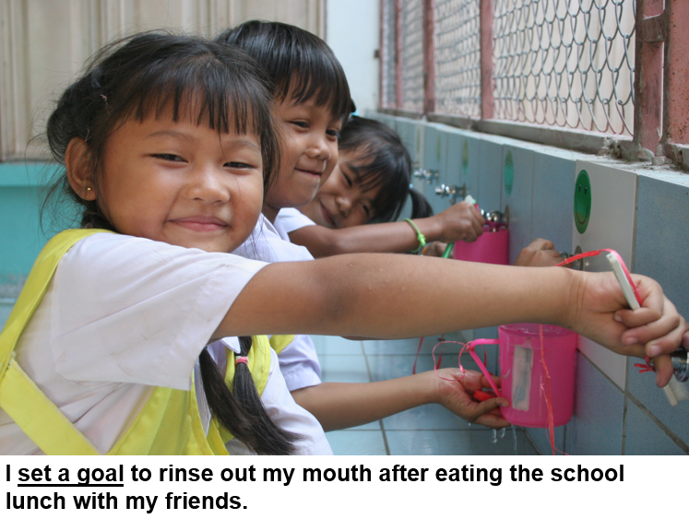
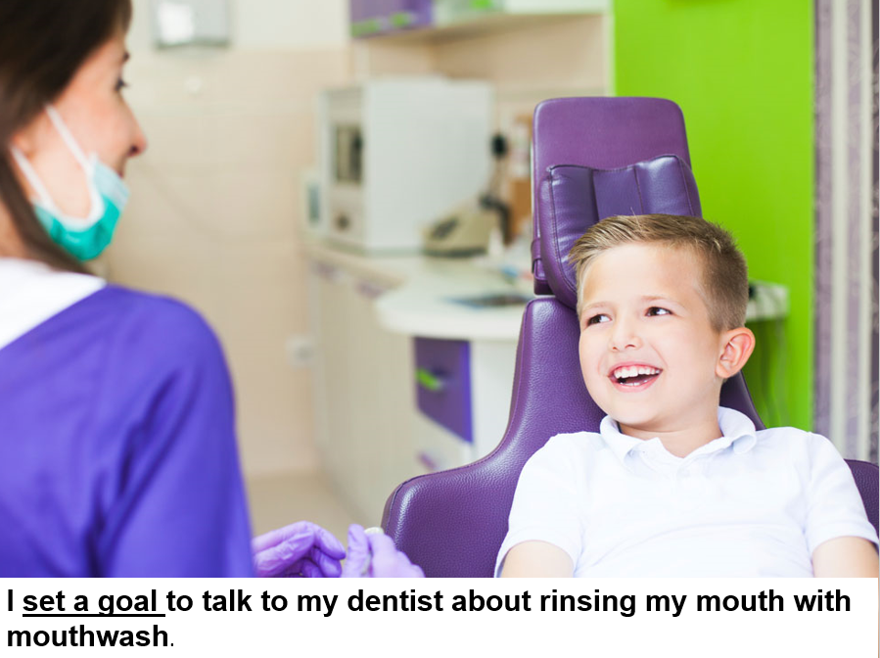
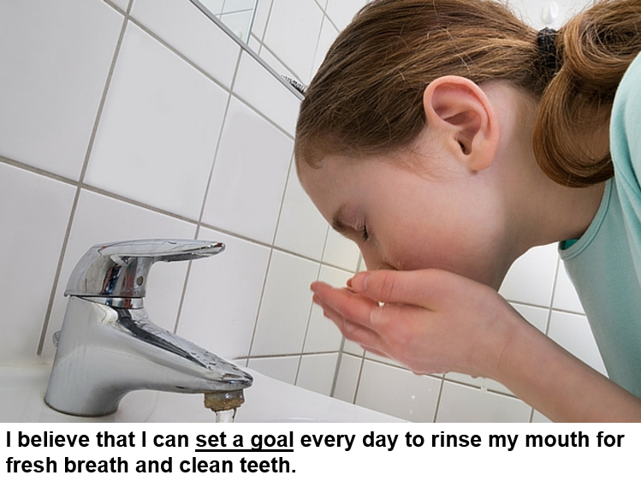
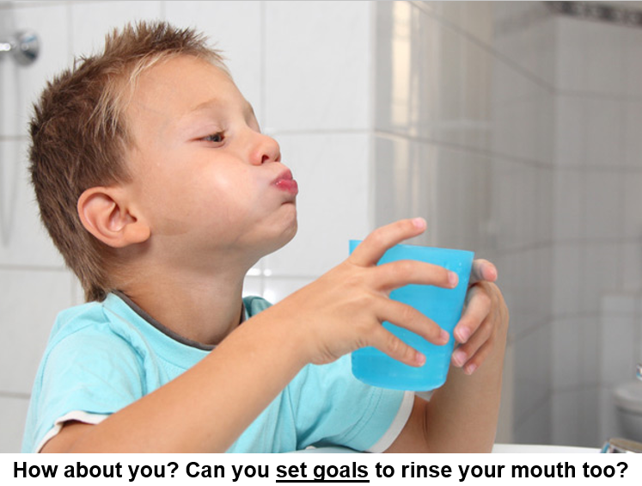
Self Efficacy Assessments of Child-Parent Dyads After Participating in an Online Oral Health Literacy Curriculum
Abby Witter & Valerie A. Ubbes, PhD, MCHES
Miami University, Oxford, OH,
Department of Biology & Department of Kinesiology and Health
Background
The eBook for Oral Health Literacy© is a free, online digital curriculum of picture stories demonstrating oral health behaviors of children at home, school, and dental clinics.
The key feature of the curriculum is teaching children about oral health behaviors while practicing reading skills and listening comprehension which builds health literacy.
By design, the eBook for Oral Health Literacy© enables children to practice literacy skills and oral health behaviors at home when absent from the school curriculum.
School absenteeism due to sick days or dental pain can be a detriment to the academic progress of students’ learning (Carroll, 2010; Jackson, 2011).
This project meets US Healthy People 2020 Objectives:
Increase the proportion of quality, health-related websites; and
    Increase the proportion of 4th and 8th grade students whose reading skills are at or above the proficient achievement level for their grade
    Three of the E-Texts were added to a larger eBook for Oral Health Literacy© project which are available as open source educational material on the Digital Literacy Partnership website (Tzoc & Ubbes, 2018).
Purpose
The purpose of this project was to design three Electronic Texts for Oral Health Literacy and to measure their effectiveness through evaluating readability, comprehension, and suitability of materials.
Procedures
Three Electronic Texts for Health Literacy© were written from a template on the topic of oral health (Ubbes, V.A., Coyle, J., & Tzoc, E., 2018).
Topical themes involved interactions of children with dental professionals, as well as hygienic practices of effective mouth rinsing.
Photos of children performing oral health behaviors accompanied the written text, which described reasons for doing the healthy habits.
Specific self-care behaviors modeled included teeth brushing, mouth rinsing, and interacting with a dental professional.
Two children were recruited to provide an audio recording of the three texts. The children read aloud with prosody (intonation and expression) using fluency (speed) to enhance the usability of the materials.
The use of children’s voices enhances and primes the readers’ identification with how to do the oral health behaviors in the photographs.
Tests of readability and suitability of materials (Doak, Doak, & Root, 1996) were used to analyze the effectiveness of the oral health curriculum. Results are shown below:
The eBook for Oral Health Literacy Curriculum is located at:
https://dlp.lib.miamioh.edu/
What is the Content of the Curriculum?
Chapter 4: Setting Daily Goals to Rinse My Mouth
Learn how to set daily goals to rinse your mouth with water after brushing your teeth. Other goals include brushing your tongue and using mouthwash for fresh breath.
Chapter 14: Setting Goals for Going to the Dentist (Boys)
Learn how to set a goal to go to the dentist for a six-month check up on your mouth, teeth, and gums. Other healthy goals include brushing daily for fresh breath and clean teeth.
Chapter 15: Setting Goals for Going to the Dentist (Girls)
Learn how to set a goal to go to the dentist for a six-month check up on your mouth, teeth, and gums. Other healthy goals include brushing daily for fresh breath and clean teeth.
Results
Suitability of Materials: Readability of Materials:
Conclusions
The Suitability Assessment of Materials classifies a score of 70-100 percent as superior material. The eBook received a score of 91%, indicating a high level of readability and ability to be comprehended.
The three readability tests showed that:
The Flesch-Kincaid Test indicated that the average reading level of the electronic texts is a 6.7 grade level.
The Fry Reading Level Test indicated that the average reading level of the electronic texts is a 6.7 grade level.
The SMOG Reading Level Test indicated that the average reading level of the electronic texts is a 5.6 grade level.
Therefore, it can be concluded that the eBook for Oral Health Literacy© is suitable for children reading between a 4th and 7th grade level.
Future research can be done to determine if electronic texts can increase the self-care self-efficacy of children in performing oral health behaviors by asking child-parent dyads a series of questions about their self-efficacy beliefs after reading a chapter of the eBook.
The front page of two electronic texts are shown below:
Category of Readability | Score out of 1
Content | 0.83
Literacy Demand | 0.90
Graphics | 1.00
Layout and type | 0.83
Learning stimulation and motivation | 1.00
Cultural appropriateness | 0.83
Total Readability Assessment | 91%
Measure of Reading Level | Average | Standard Deviation
Average number words in a sentence | 17.26 | NA
Flesch-Kincaid Test | 6.7 | 1.51
Fry Reading Level | 6.7 | 1.56
SMOG Reading Level | 5.6 | 1.16
Visual-Textural-Gestural material is very important for helping children to learn through multi-modal and multi-sensory ways. Each chapter of the eBook curriculum contains the following topics, e.g. people, objects, and actions.
 | Visual-Textual-Gestural Characteristics of Each Page | Chapter 4 Content Frequency | Chapter 14 Content Frequency | Chapter 15 Content Frequency
People | Boy | 5.5 | 9 | 0
 | Girl | 5 | 0.5 | 10
 | Peers | 1 | 1 | 1
 | Parents (Mom or Dad) | 1 | 1 | 1
 | Dental Provider | 0.5 | 2.5 | 3.5
Objects | Teeth | 2 | 5 | 5
 | Toothbrush | 1 | 2.5 | 2.5
 | Rinse Cup | 5 | 0 | 0
 | Mouthwash | 1 | 0 | 0
Actions | Rinsing | 7 | 0 | 0
 | Interacting with child in clinical care | 0.5 | 6 | 9
 | Goal Setting | 10 | 10 | 10
The eBook design is theory aligned. The textual narrative is based on three types of salient beliefs in the Theory of Reasoned Action. Each chapter includes a self efficacy belief (n = 1), health outcome beliefs (n = 3), normative beliefs (n = 3), another self efficacy belief (n = 1), and interactive health literacy (n = 1).
An example of a third electronic text from the larger eBook for Oral Health Literacy© is shown below in sequential order:
Notes:
1
-adding standard deviations
-adding references

